Slide 1

Web scraping with R/Python

Slide 2
Outline
Welcome to Workshop. Introduce Instructor
HTML Data Format
Use Cases for Web Scraping and APIs
Python/R Web Scraping Packages (BeautifulSoup, Selenium / Rvest RSelenium)
Live Coding Demo
Web Scraping Projects I have worked on.
Evaluation Form
Additional Learning Resources

Slide 3
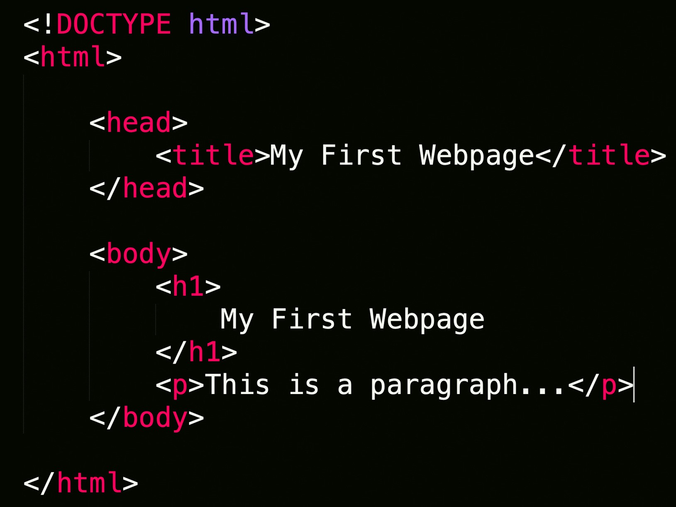
Web Scraping
Extraction of data from a website.
Loads HTML code from URL. User selects which content to keep

Slide 4


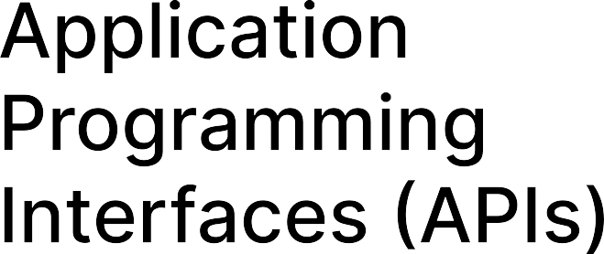
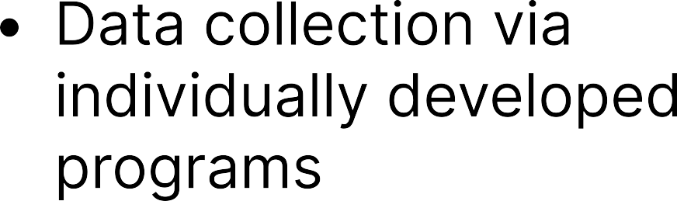

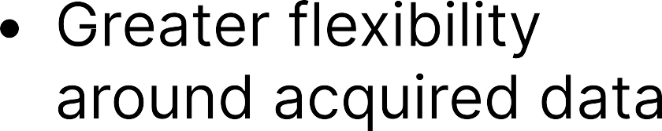
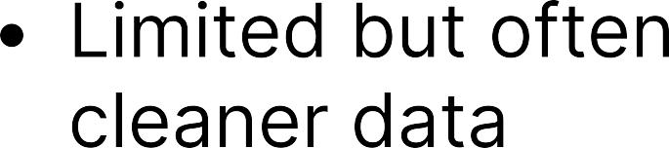
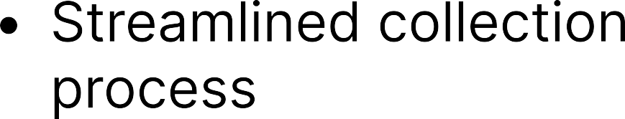


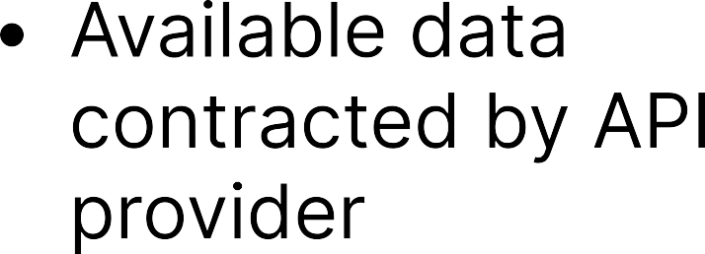
Web Scraping VS APIS

Slide 5
Python/R Packages for Web Scraping
BeautifulSoup/RVest
Selenium/RSelenium
Most User Friendly. Less flexible
Navigates static webpages.
More complex, but greater flexibility.
Navigates webpage interactively.

Slide 6
Coding Demos
Github Page.
Running code through Binder
Install R/RStudio

Slide 7
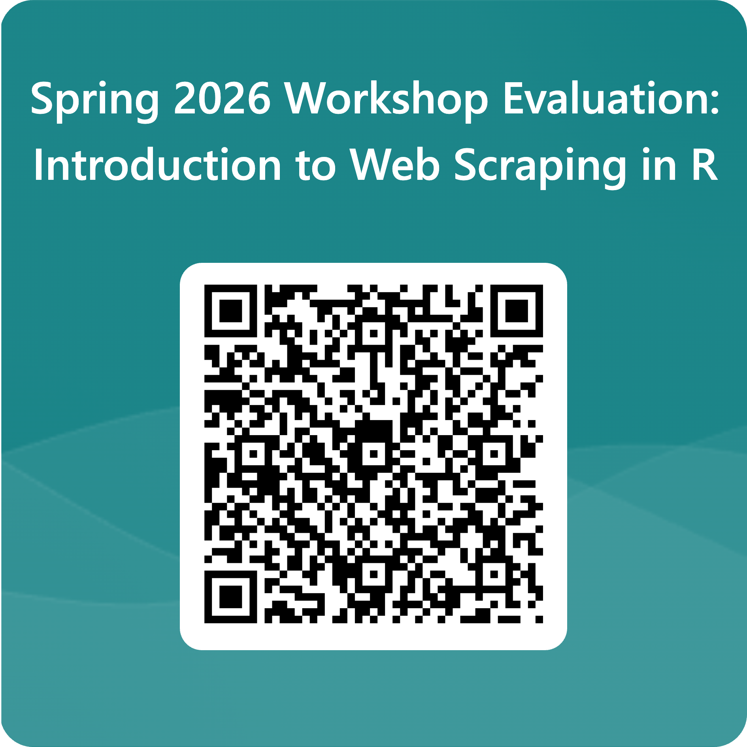
Evaluation

